Slide 1

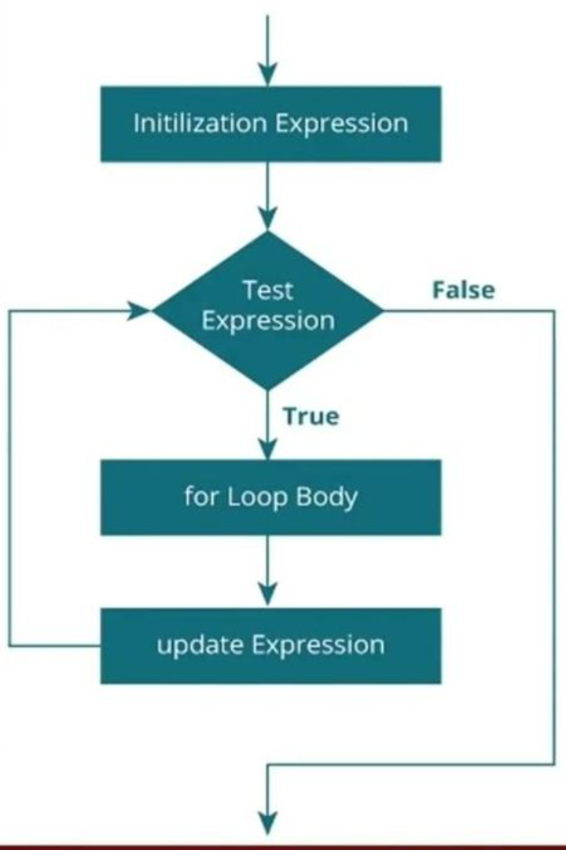
Looping in C Language
Welcome to the world of loops in the C programming language! Loops allow us to repeat a block of code multiple times, making our programs powerful and efficient.

Slide 2

What is Looping?
Looping is a fundamental concept in programming that enables us to execute a set of instructions repeatedly based on a specific condition. It eliminates the need for writing repetitive code manually.

Slide 3

Why is Looping Important in Programming?
Looping is crucial in programming as it allows us to automate repetitive tasks, process large amounts of data, and solve complex problems efficiently. It helps in increasing productivity and reducing code redundancy.

Slide 4

For Loop
The for loop is widely used for iterative tasks. It consists of an initialization section, a condition section, and an increment section. It provides precise control over the number of iterations.

Slide 5

Example of For Loop
Let's say we want to print the numbers 1 to 5 using a for loop:
for (int i = 1; i <= 5; i++) {
printf("%d ", i);
}

Slide 6

Nested For Loop
In C, we can nest one or more for loops within another for loop. This allows us to perform complex iterative operations, enabling us to work with multi-dimensional data structures, such as matrices.

Slide 7

While Loop
The while loop executes a block of code repeatedly as long as a specified condition remains true. It is useful when the exact number of iterations is unknown or when iterating over collections.

Slide 8

Example of While Loop
Here's an example of a while loop that prints the even numbers from 2 to 10:
int i = 2;
while (i <= 10) {
printf("%d ", i);
i += 2;
}

Slide 9

Nested While Loop
In C, we can nest one or more while loops within another while loop. This can be handy when dealing with scenarios where multiple conditions need to be satisfied concurrently.

Slide 10
Do-While Loop
The do-while loop is similar to the while loop but with a slight difference. The code block is executed first, and then the condition is evaluated. This guarantees that the code inside the loop executes at least once.

Slide 11
Example of Do-While Loop
Let's see an example of a do-while loop that prompts the user for input until a valid password is entered:
char password[20];
do {
printf("Enter password: ");
scanf("%s", password);
} while (strcmp(password, "secret") != 0);

Slide 12

Nested Do-While Loop
C supports nesting do-while loops within another do-while loop. This provides flexibility when dealing with situations that require a loop to be executed repeatedly, both internally and externally.

Slide 13
Difference between For, While, and Do-While
For Loop
While Loop
Do-While Loop
Statement(s) is executed once the condition is checked.
Condition is checked first then statement(s) is executed.
Condition is checked after the statement(s) is executed.
It might be that statement(s) gets executed zero times.
It might occur statement(s) is executed zero times, If condition is false.
Statement(s) is executed at least once.
do-while is exit controlled loop.
for loop is entry controlled loop.
while loop is entry controlled loop.
do { statement(s); } while (condition);
for ( init ; condition ; iteration ) { statement (s); }
while(condition) { statement(s); }

Slide 14
Outputting Results of a Loop
Loops can be used not only to repeat code but also to generate valuable results. We can print values, perform calculations, or store data inside arrays, matrices, or other data structures.

Slide 15
Conclusion
Mastering looping in C language opens up a world of possibilities for writing efficient and powerful programs. With the knowledge of different loop types, you can solve complex problems and make your code more elegant and concise.

